Slide 1
Gene Expression
Role of DNA

Slide 2
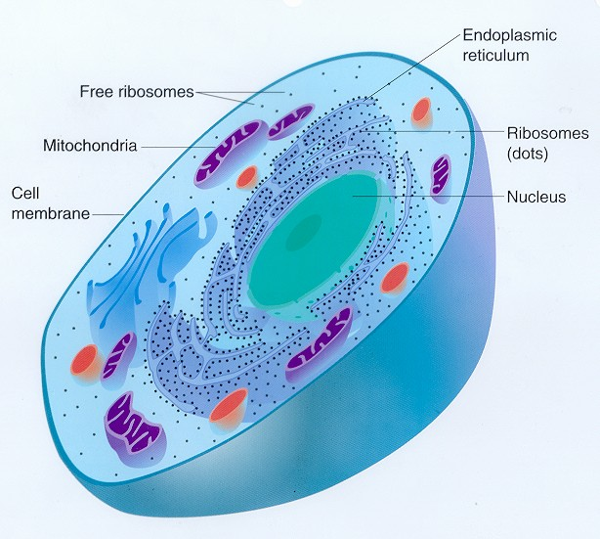
Where is DNA?
In the chromosomes in the nucleus

Slide 3
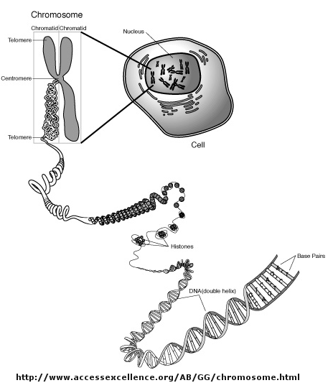
Packaging of DNA
packaging

Slide 4
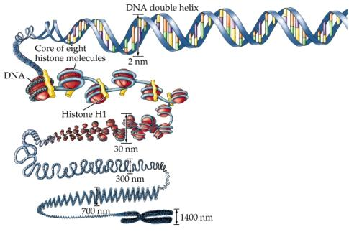
Packaging of DNA - Eukaryotes
  Wound around histones which are groups of 8 protein molecules
  Another histone is on the outside. The group is called a nucleosome
  3. The nucleosomes are coiled
  4. The coil is then looped
  5. The looped strand is coiled again
  6. It is then folded to form the shape we recognise as a chromosome

Slide 5
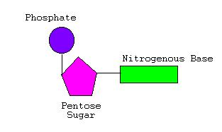
Nucleotides
Nucleic acids are polymers of nucleotides.
  = chains of nucleotide units
Nucleotides have 3 parts
  The 5 Carbon (pentose) sugar
  A phosphate group
  A nitrogen base
A simple model

Slide 6
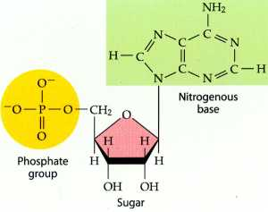
Here is a more detailed model of a nucleotide

Slide 7
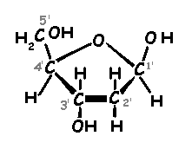
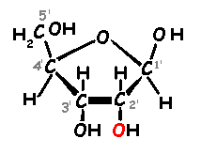
Types of nucleic acid
There are two types, named according to the 5-carbon sugar they have
DNA – Deoxyribose Nucleic Acid
RNA - Ribose Nucleic Acid
Deoxyribose
Ribose

Slide 8
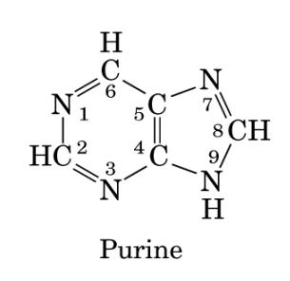
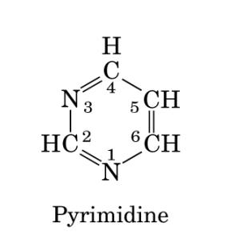
Bases
There are two types of bases
Purines have a 2-ring structure
Pyrimidines have one ring
Examples: Thymine and Cytosine (and Uracil in RNA)
Examples: Adenine and Guanine

Slide 9
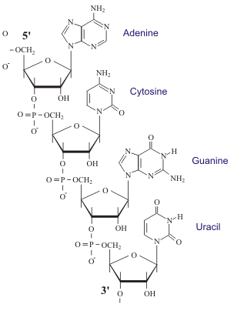
RNA – Ribose Nucleic Acid
RNA is a single strand of linked nucleotides
Comparison of RNA with DNA
Ribose not deoxyribose
Uracil not thymine
Single strand not double
Less stable
RNA molecules much shorter

Slide 10
DNA Structure
DNA is a polymer of nucleotides
Each nucleotide consists of
    deoxyribose sugar
    A phosphate
    A base – Adenine, Thymine, Cytosine or Guanine
A DNA molecule consists of two chains of nucleotides twisted around each other to form a double helix.

Slide 11
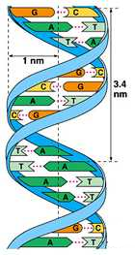
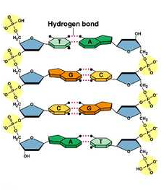
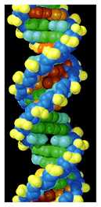
DNA Models
Alternating sugars and phosphates form the sides of the DNA “ladder”
The rungs are formed by the bases in complementary pairs. A – T and C – G
And this is a space-filling model of DNA
Let’s give it a twist to make the double helix
Here is the ladder

Slide 12
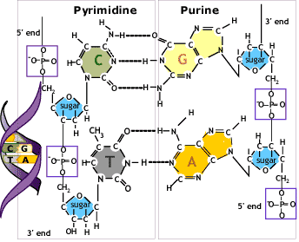
Note: each base pair consists of a pyrimidine and a purine.
This keeps the sides of the ladder parallel

Slide 13
Cytosine has three weak hydrogen bonds with Guanine
Adenine has two weak hydrogen bonds with Thymine

Slide 14
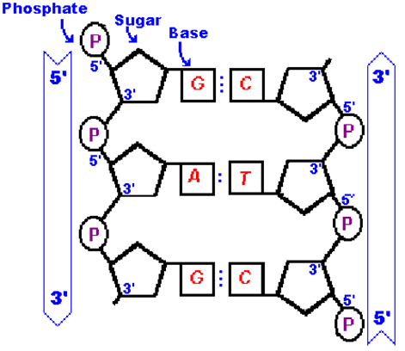
The phosphates are joined to the 3’ and 5’ carbon atoms of the sugar
The two nucleotide strands run in opposite directions
They are ‘anti parallel’
NOTE:
This may not be required for this standard
(but is for the Cells Standard for replication)

Slide 15
NOTE:
The template strand is the DNA strand to which RNA nucleotides temporarily bond make mRNA. It is complementary to the RNA produced (and to the coding strand)
(Template strand = “antisense strand”)
The coding strand is the DNA strand which has the same base sequence as the RNA transcript produced.
(Coding strand = “sense strand”)

